Slide 1
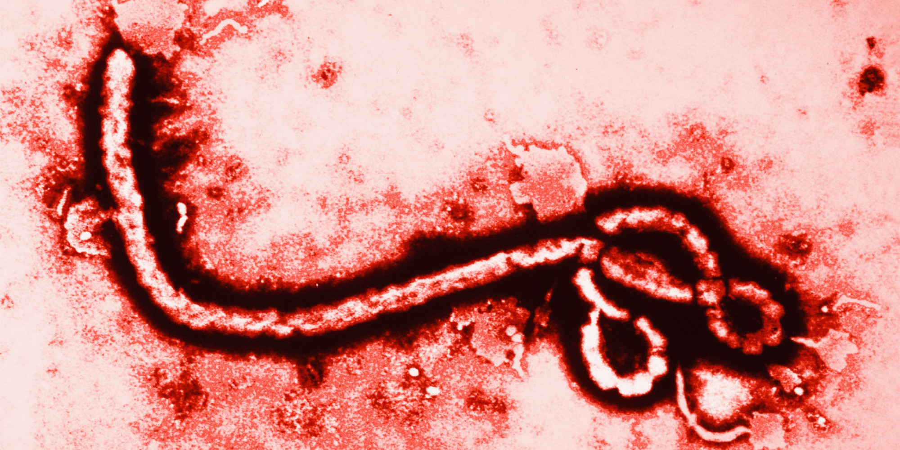

Anti-Virus
Presented by

Slide 2
Firewall
A firewall is considered a first line of defense in protecting private information. For greater security, data can be encrypted.
It acts as a prevention tool, and makes your device hidden from the internet
Notes:
A program that defends your computer from malicious users accessing and using your computer either as a port to someone else’s computer or to totally mess up yours

Slide 3
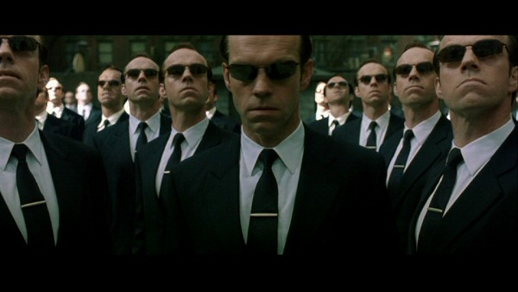
ANTI-VIRUS

Slide 4
ANTI-VIRUS
A layer of protection that prevents devices from getting malicious program/s

Slide 5
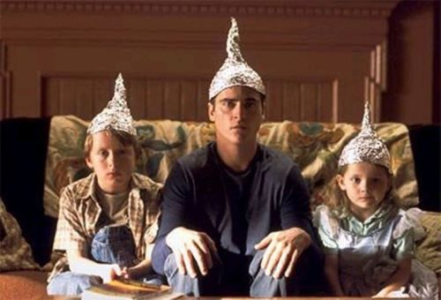
Schemes
Not all anti-virus are at your side
Research before actually committing to a software
Validate that is a trusted company

Slide 6
Credible Anti-Virus
Premiums
Kaspersky
Norton
Vipre
Free Anti-virus (premium upgrade)
Avast
AVG
Comodo

Slide 7
MALWARE SCANNER
Detects malware already installed in the computer
Usually paired with Anti-virus software

Slide 8
BACKUPS
External Storage
Best back up solution
Cloud Storage
Pros: can be access anywhere
Con: privacy issues
Restore Points
Not recommend as an ONLY backup solution but it’s better than nothing.

Slide 9
RULE 3-2-1
MAKE 3 BACKUPS
2 IN DIFFERENT FORMATS
FAT32, NTFS, EXT4 CLOUD STOREAGE
1 COPY OFFSITE
MAKE AN EXTERNAL COPY

